Slide 1

Azure Notebooks
UCL MICROSOFT STUDENT PARTNERS
November 28th 2017

Slide 2

Azure Notebooks
Cloud-based service for building, editing, and sharing Jupyter notebooks
Currently free; only requires a modern browser and a Microsoft ID
Supports Python, R, and F#
https://notebooks.azure.com/
Notes:
Azure notebooks are at the core Jupyter notebooks. Azure provides from value added services for managing and sharing notebooks with others as well as a free environment for editing and running notebooks. The service is completely contained within a browser, so there’s no need to install any special software, libraries, or run times. With a modern web browser and a Microsoft ID, one can be running notebooks in no time – no strings attached.

Slide 3
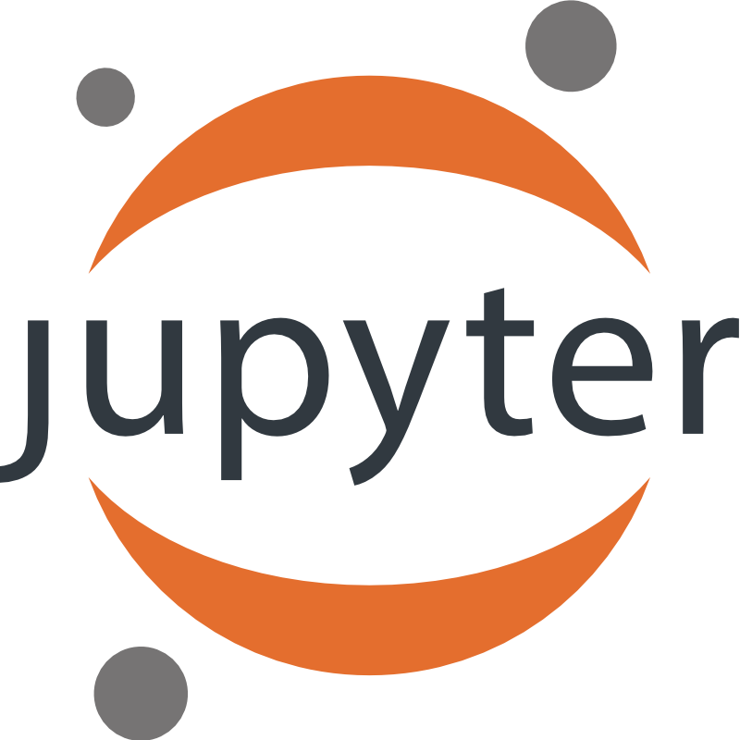
Jupyter
“The Jupyter Notebook is an open-source web application that allows you to create and share documents that contain live code, equations, visualizations and explanatory text. “
Notes:
Jupyter is a web-based applications for editing and running notebooks. It supports a number of languages including Python, R, and F#. The interactive nature of Jupyter makes it very useful for teaching and presentations in a live environment. Notebooks are intended to be shared and presented across Jupyter platforms. The nexus of these features makes Jupyter useful for data cleaning and transformation, numerical simulation, statistical modeling, machine learning, teaching, and even learning how to code.

Slide 4
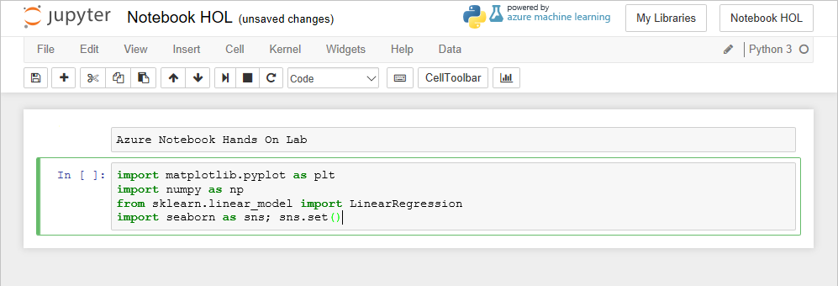
Notebooks
Notebooks are composed of cells
Markdown cells contain text (headings, notes, etc.)
Code cells contain executable code
Notes:
Notebook files contain code and markdown that annotates the code. These together allow the notebook to be edited and executed interactively, which makes them ideal for teaching, study, experimentation, and many other uses. Azure notebook currently supports three languages, each with a specific use and intended audience. The choices of libraries in those languages too enables a very powerful environment for doing all sorts of tasks.
Markdown Cells and Code Cells can be interspersed among one another. There is only a theoretical limit to the number of cells that can be contained in a notebook, so ideally code and content should be broken up into bite size pieces rather than a single cell containing everything. Commentary uses Markdown syntax while the code cells contain whatever programming language is being used in the notebook.

Slide 5
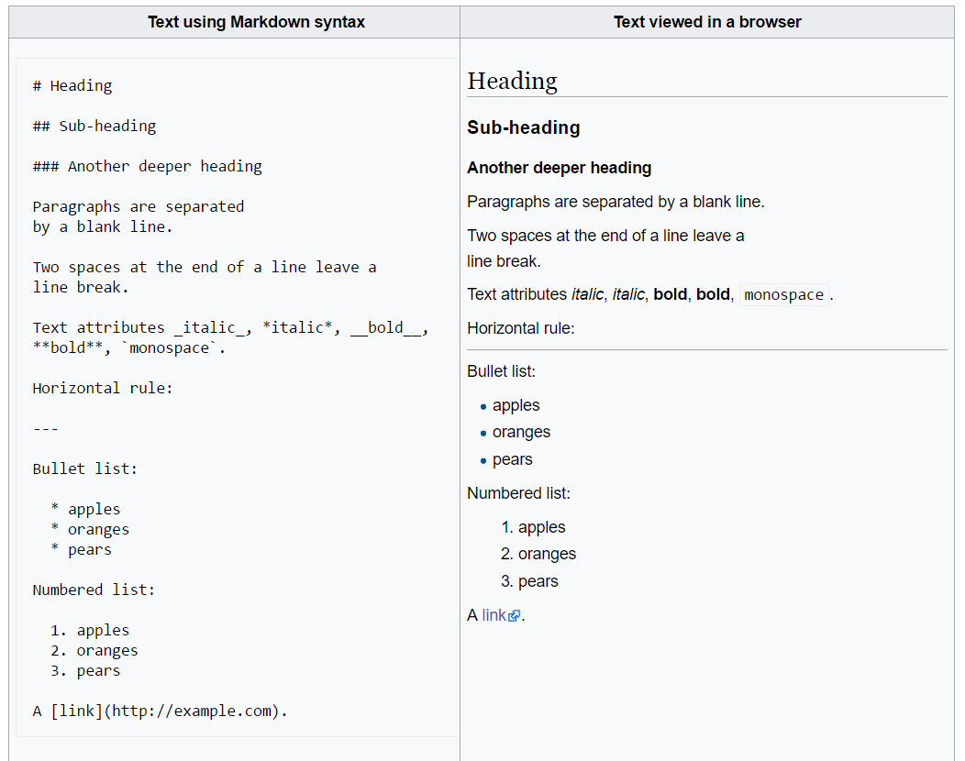
Markdown
Markdown is a text format.
It uses symbols instead of tags to format text.
Markdown is a popular format for documentation, and is used to present text in Notebooks.
https://github.com/adam-p/markdown-here/wiki/Markdown-Cheatsheet
Notes:
Markdown has become immensely popular for documentation in recent years due to it’s simplicity and readability. Markdown does not supply a rich set of tags and stylesheets, rather simply uses symbols to control formatting. The resulting document is not pixel perfect, but allows it to be adapted and displayed on a number of devices and media including non-GUI media like CLI’s.

Slide 6

Python
Python is a multipurpose programming language that is widely used in data science
Its simplicity makes it a popular choice for entry-level programming courses and also for data scientists
https://www.python.org/
Notes:
From its inception, Python has aimed at simplicity and code readability. Code blocks are formatted using indentations rather than brackets, braces, ending statements. This makes it easy to determine the code branches in a Python program. For this reason, it has become a favorite language among those who need access to a programming language but aren’t developers or computer scientists themselves. Given its reach into academia, a number of powerful tools for doing analysis have been developed for Python.

Slide 7
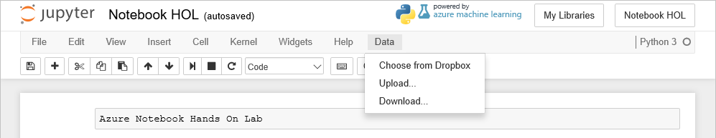
Getting Data In and Out
Data can be uploaded to Azure Notebooks through the Data menu, and then loaded into memory using function calls
Data can also be downloaded or supplied through DropBox
Notes:
Data is easily uploaded to a notebook through options in the Data menu. Azure notebooks can host the data along side the notebook and it can be imported using a library or function available in whatever programming language the notebook is using.

Slide 8
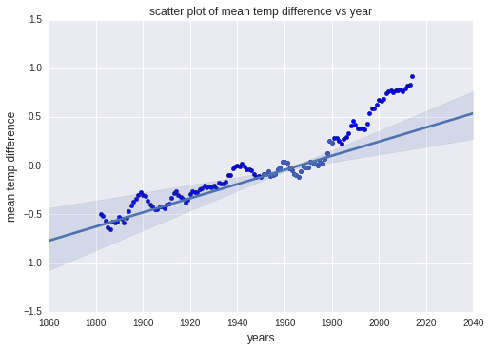
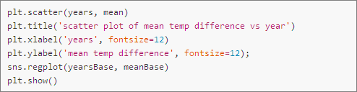
Visualizating Data
Popular packages such as Matplotlib and Seaborn make visualizations easy and are fully supported in Azure Notebooks
Notes:
A picture is worth a thousand words, so the adage goes. In Jupyter, visualizations can be generated from data and displayed inline with code cells or as part of slideshows. This is handy for plotting data in real time and updating visualizations with updates to code.

Slide 9
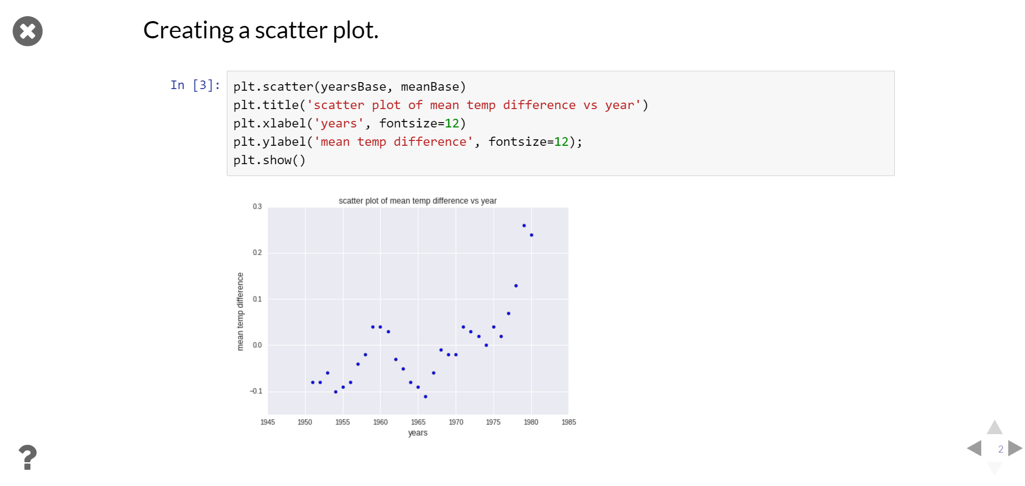
Slideshows
Slideshows are easily created from Azure Notebooks
Designate a behavior for each cell (e.g., slide or fragment) and click a button to enter slideshow mode
Notes:
The slideshow feature of notebooks enables presenters to share the notebooks and still interact with the notebook without having to install any special software. This feature is useful for doing presentations of data, results, tests, or in aiding instruction.

Slide 10
Let’s Get Started!
Github repo with resources:
https://github.com/ChrisDO99/UCL-Azure-Notebooks-Event
Navigate to https://notebooks.azure.com and login with your Microsoft Account.

Slide 11
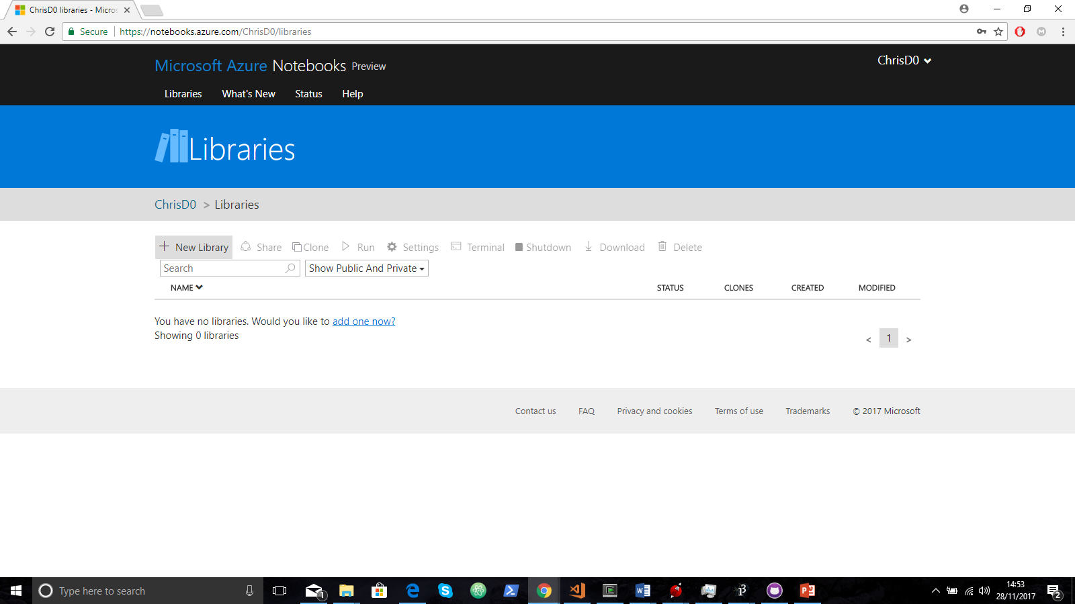

Slide 12
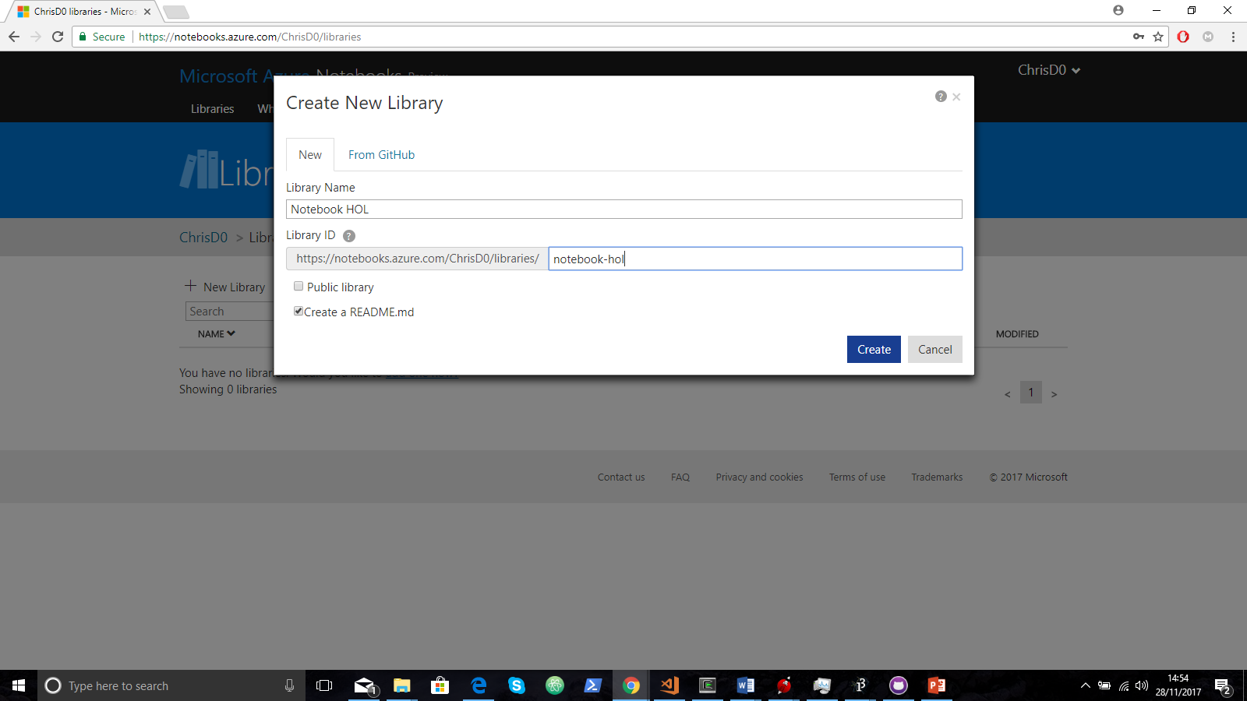

Slide 13
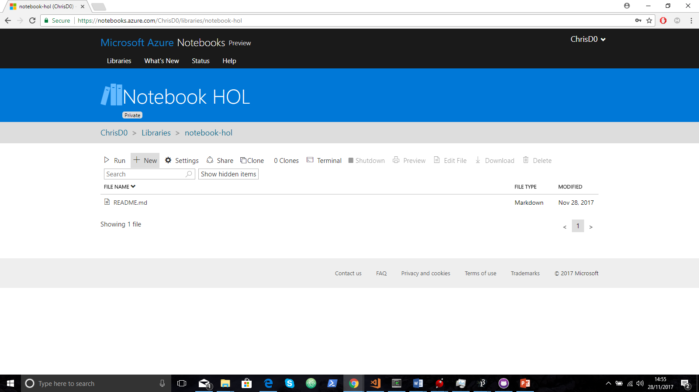

Slide 14
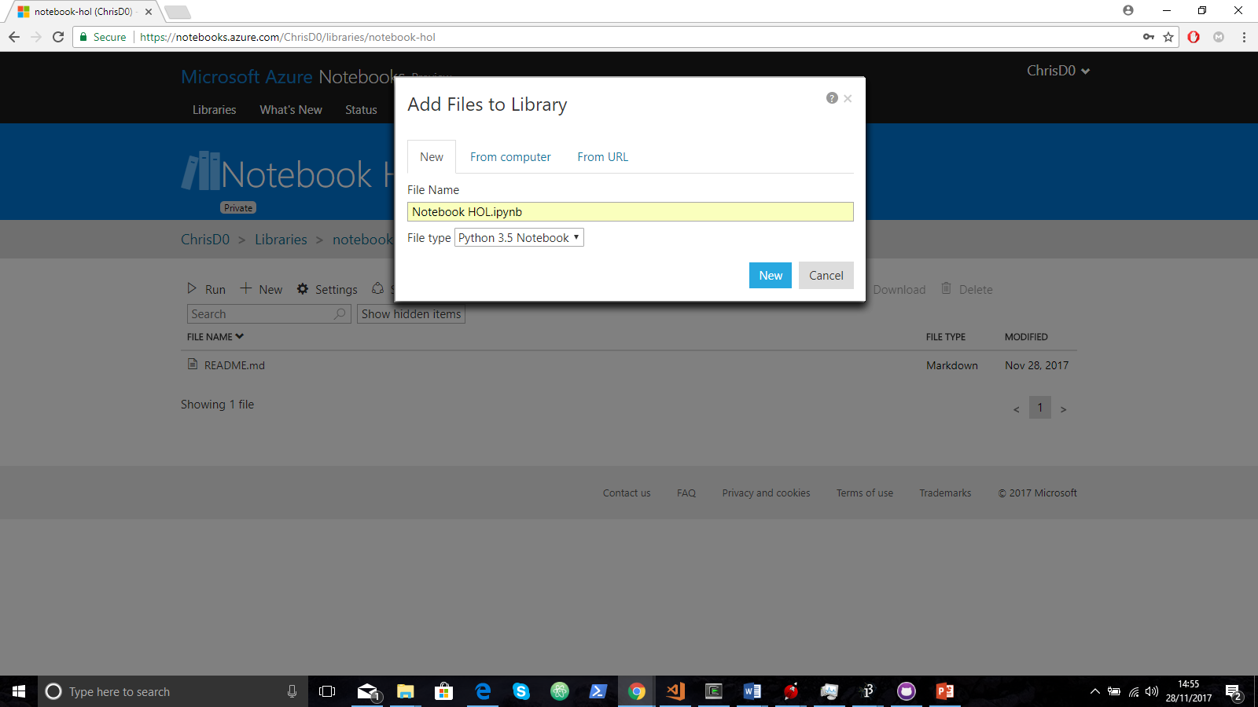

Slide 15
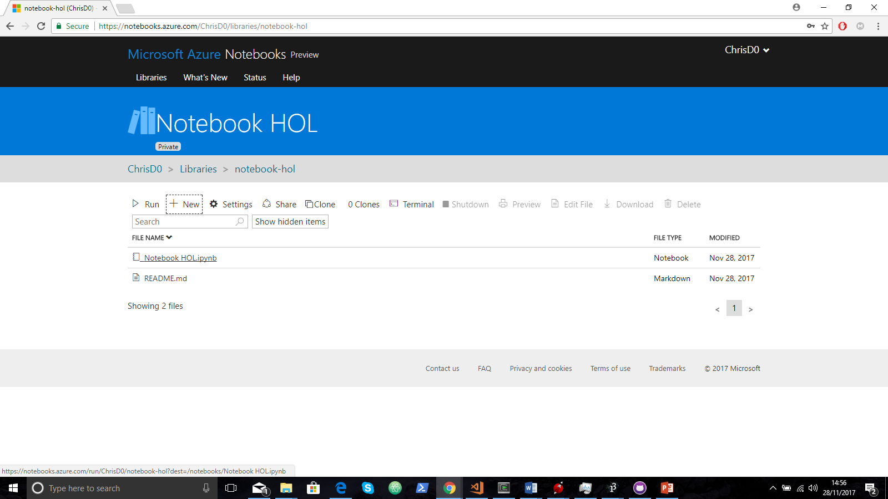

Slide 16
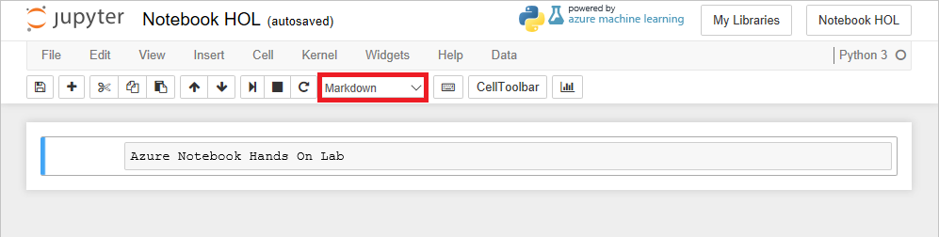
In the first cell, set the cell type to Markdown and enter the "Azure Notebook Hands On Lab" into the cell itself:

Slide 17
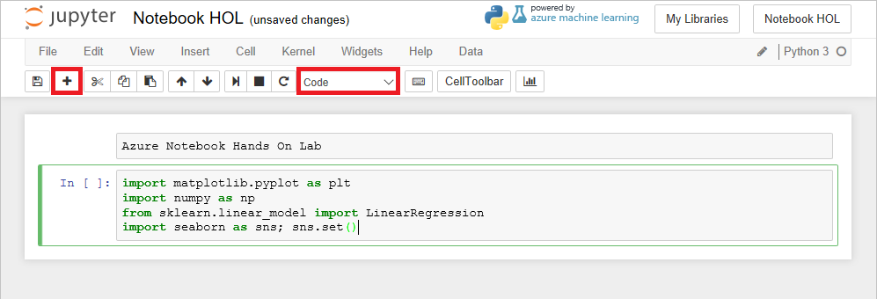
Click the + button in the toolbar to add a new cell. Make sure the cell type is Code, and then enter the following Python code into the cell:

Slide 18
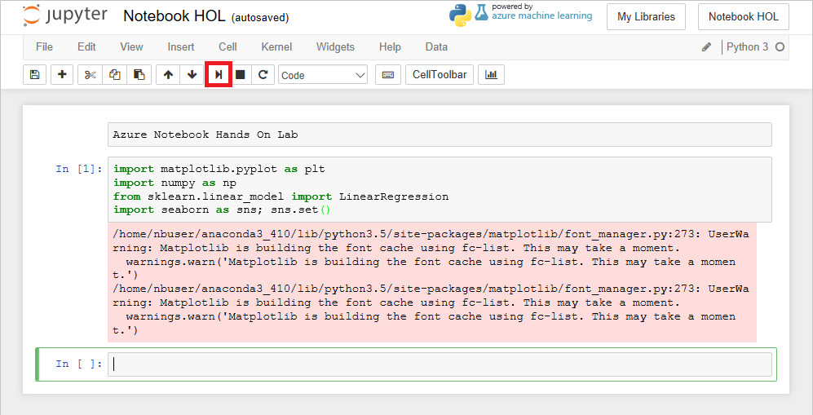

Slide 19
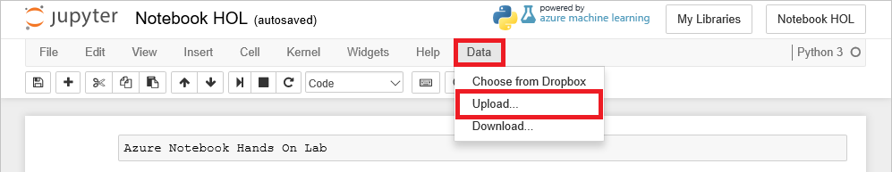
Notes:
Destination Folder Library

Slide 20
Once you’ve uploaded the two data files:
Add a new markdown cell with “Import Data” as the text.
Add a code cell with the following exact code. This specifies variables using the input data:
yearsBase, meanBase = np.loadtxt('5-year-mean-1951-1980.csv', delimiter=',', usecols=(0, 1), unpack=True)
years, mean = np.loadtxt('5-year-mean-1882-2014.csv', delimiter=',', usecols=(0, 1), unpack=True)

Slide 21
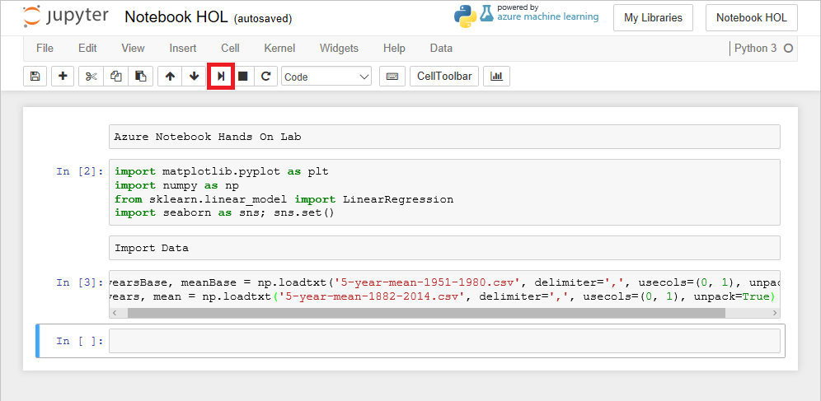

Slide 22
1. Add a new markdown cell with “Linear Regression Graph” as the text.
2. In a new code cell, add the following code. It will plot the graph as well as a regression line as well!
# Creates a linear regression from the data points
m,b = np.polyfit(yearsBase, meanBase, 1)
# This is a simple y = mx + b line function
def f(x):
return m*x + b
# This generates a scatter plot, but adds a line plot using the function above
plt.scatter(yearsBase, meanBase)
plt.plot(yearsBase, f(yearsBase))
plt.title('scatter plot of mean temp difference vs year')
plt.xlabel('years', fontsize=12)
plt.ylabel('mean temp difference', fontsize=12);
plt.show()
# Prints text to the screen showing the computed values of m and b
print(' y = {0} * x + {1}'.format(m, b))
plt.show()

Slide 23
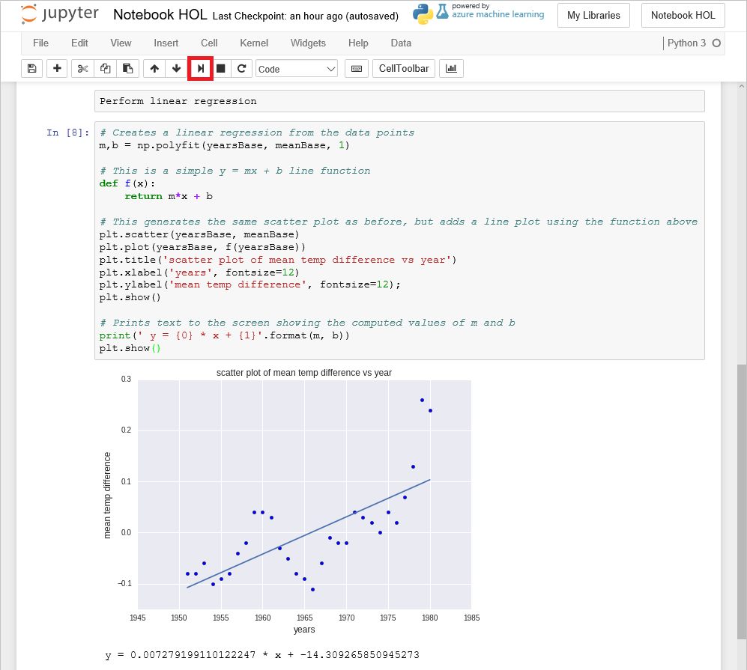

Slide 24
Next up,
Add a new markdown cell with “Linear Regression with Seaborn” as the text.
Add a code cell with the following code to use Seaborn to show the graph & expected range for the values for the second dataset!
plt.scatter(years, mean)
plt.title('scatter plot of mean temp difference vs year')
plt.xlabel('years', fontsize=12)
plt.ylabel('mean temp difference', fontsize=12);
sns.regplot(yearsBase, meanBase)
plt.show()

Slide 25
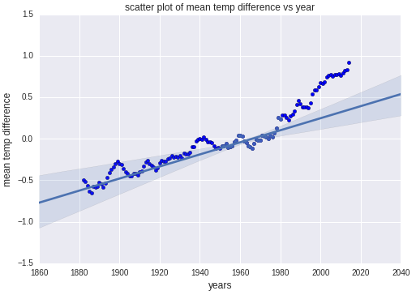

Slide 26
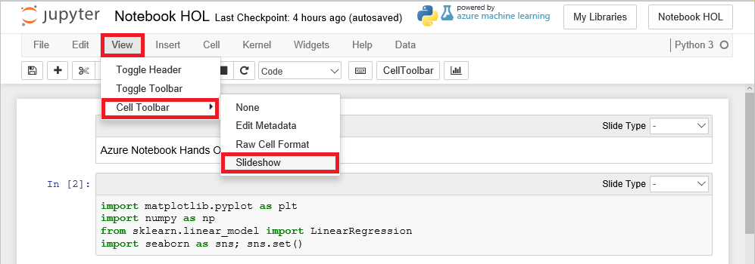
Slideshow Capability

Slide 27
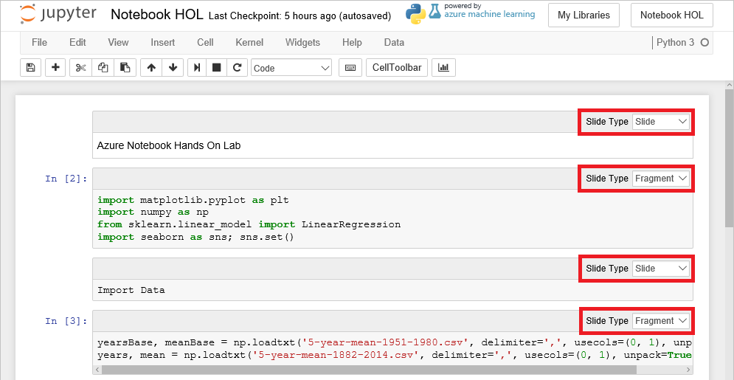
Set the Slide Type for each markdown cell in the notebook to Slide. Set the Slide Type for each code cell to Fragment.

Slide 28
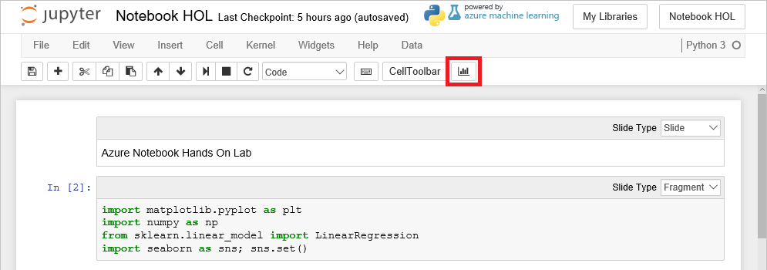
Enjoy your Slideshow!

Slide 29
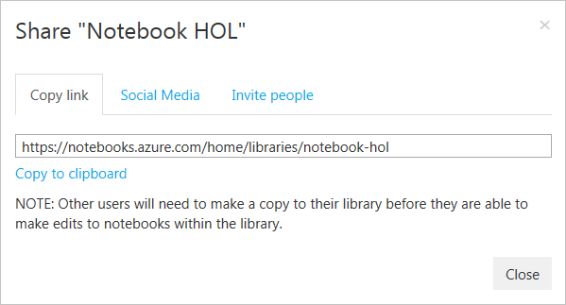
Sharing Notebooks
Notebooks can be shared via URL, social media, or e-mail
Great for collaboration or simply sharing & displaying results
Notes:
Notebooks can be kept private, but if you choose to make the library containing the notebook public, then you can share the notebook as well.

